Slide 1
connectBlue Medical Demo Board
High Level Design and description
September 6, 2011

Slide 2
sw0
electrode
Dig.
I/O1
Switch-0
ECG Analog
Dig.
I/O10
LED
Heart beat
(yellow)
A/D
Input0
cB
OBI411
samsung
FSI-120-03-G-D-M-AB
Dig.
I/O2
LED
Red
electrode
Dig.
I/O3
LED
Green
A/D
Input1
Dig.
I/O4
LED
Blue
Linear
Regulator
3.3v out
R
Divider
Nonin iPod Oximeter
UART
Vbatt
2.1mm pwr
connector
DB-9 connector
P2=UART RxD
P3=UART TxD
P5=GND
P9=vBatt (5-6V, 60mA)
battery
battery
battery
battery

Slide 3
Android display
HR
98
SpO2
98
Battery
5.75V
ECG Waveform, moving erase bar
*** FOR DEMONSTRATION PURPOSES ONLY ***
*** NOT FOR PATIENT USE ***

Slide 4
Documentation
cB-OBI411 Bluetooth IO Specification
Functional descriptions
IO and ADC pinouts and electrical characteristics
IO protocol and configuration commands
cB-OBS411 Electrical and Mechanical data sheet
J2, J3 pinouts
Samsung connector order info
Power information
LED and Switch connections
Serial Port Adapter AT Commands
Knatte 3 schematic for reference
Power supply and power connector (2.1mm)
LEDs
Switch-0
Nonin iPod Specification sheet
ECG analog reference design
See following pages
OBS411 Apple & Android
Technical support email with Android Chat reference application (separate email forward)

Slide 5
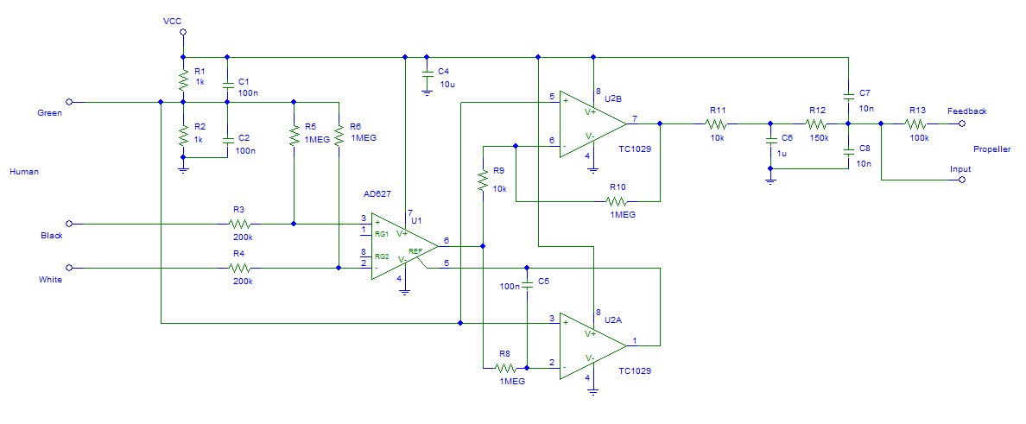
ECG circuitry
From: http://www.rayslogic.com/propeller/Programming/PropEKG/PropEKG.htm
Note: ** Adjust as appropriate for 1.8V full scale input on OBI411

Slide 6
Circuit design (from website)
A complete circuit diagram of one channel of the analog EKG circuit is shown in figure above.. The circuit board has provisions for two identical channels, although only one is required for basic operation. The only active components are two 8-pin DIP amplifiers, the AD627 instrument amplifier (U1) and the TC1029 dual OPAMP (U2A and U2B).
An analog ground at Vcc/2 is formed by the resistor divider of R1 and R2. C1 and C2 are used to filter high frequency transients from this analog ground. In the usual case, the body is connected to this ground using the green wire (but, this grounding is not always necessary when operated from battery power).
The AD627 instrument amplifier amplifies the very small EKG voltage coming in through the black and white wires, through R3 and R4. R5 and R6 pull down these inputs to analog ground and reduce noise and allow single channel operation without the green wire. The AD627 has the impressive ability to amplify the EKG signal above the noise floor even with a large amount of common mode noise on the inputs. With pins 1 and 8 not connected, the AD627 has the default of 5X, which gives the maximum common-mode rejection
U2A, one of the two opamps of the TC1029 chip, is configured as an error integrator with R8 and C5. It’s function is to gently force the output level of the AD627 to be close to the analog ground (Vcc/2). This is done by integrating the difference between the output of the AD627 and analog ground and feeding the result into the ground reference pin of the AD627. This is necessary because the 100X amplification of the AD627’s output performed by U2B, the second opamp of the TC1029, and the need to stay within the power supply rails. U2B is configured as a simple 100X inverting amplifier using R9 and R10 with analog ground as reference.
R11 and C6 form a low-pass filter on the output of U2B. This is fed to Propeller ADC (analog-to-digital conversion) circuit formed by R12, R13, C7 and C8.

